Slide 1
Producer and Consumer Problem
08/08/2021

Slide 2
General
Producer and consumer have to notify each other once their respective jobs are completed
Buffer (a bucket kinda) → Consumer locks a mutex and produces something and then puts the data into the buffer
Prod notifies consumer and if you are waiting, go consume
Prod releases mutex lock and consumer takes the data from the buffer (buffer now has nothing in it)
Cycle keeps happening until producer stops producing
There can be many producers to one consumer thread as well
Producer and consumer SHARE ONE MUTEX ***
Condition variable →
Prod: is the buffer full? If it is, the consumer may not be able to consume fast enough so WAIT
Cons: Buffer has to have atleast 1 or WAIT
Use the same condition variable for notifying and waiting so the right wait is notified

Slide 3
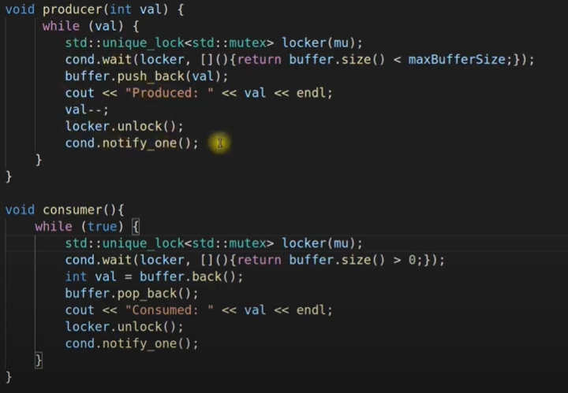
Example
Producer is able to produce more than one at a time while consumer is waiting and vice versa
Depends on CPU speed during the wait periods. This isn't a one prod, one cons scenario necessarily bc they’re running at the same time

